Slide 1
Biomedical Imaging Introduction
Sebastian Kozerke
Institute for Biomedical Engineering, University and ETH Zurich, Switzerland

Slide 2
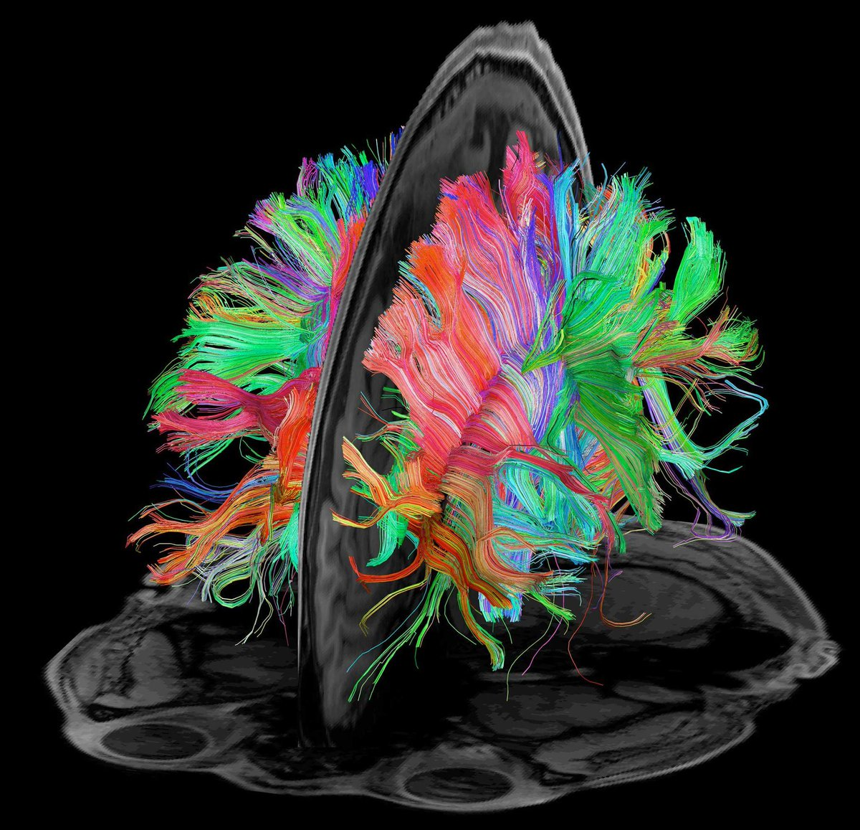
A picture is worth a thousand words

Slide 3
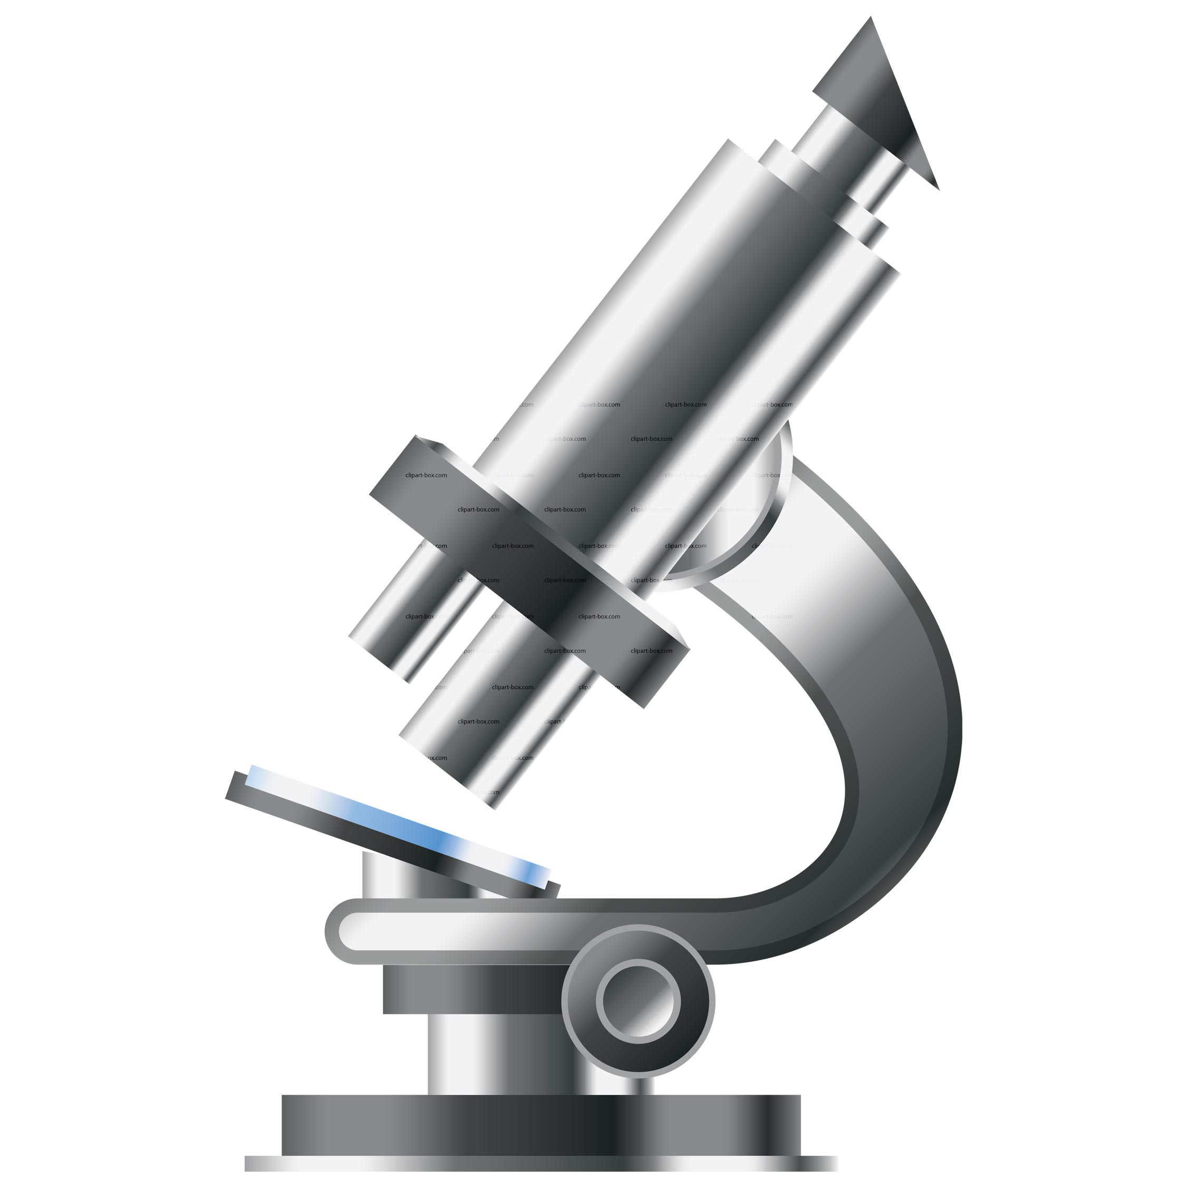
Imaging across scales
Proteins : nm
1 : 10⁹
Body : m
Synapse : msec
1 : 10¹⁰
Life : years

Slide 4
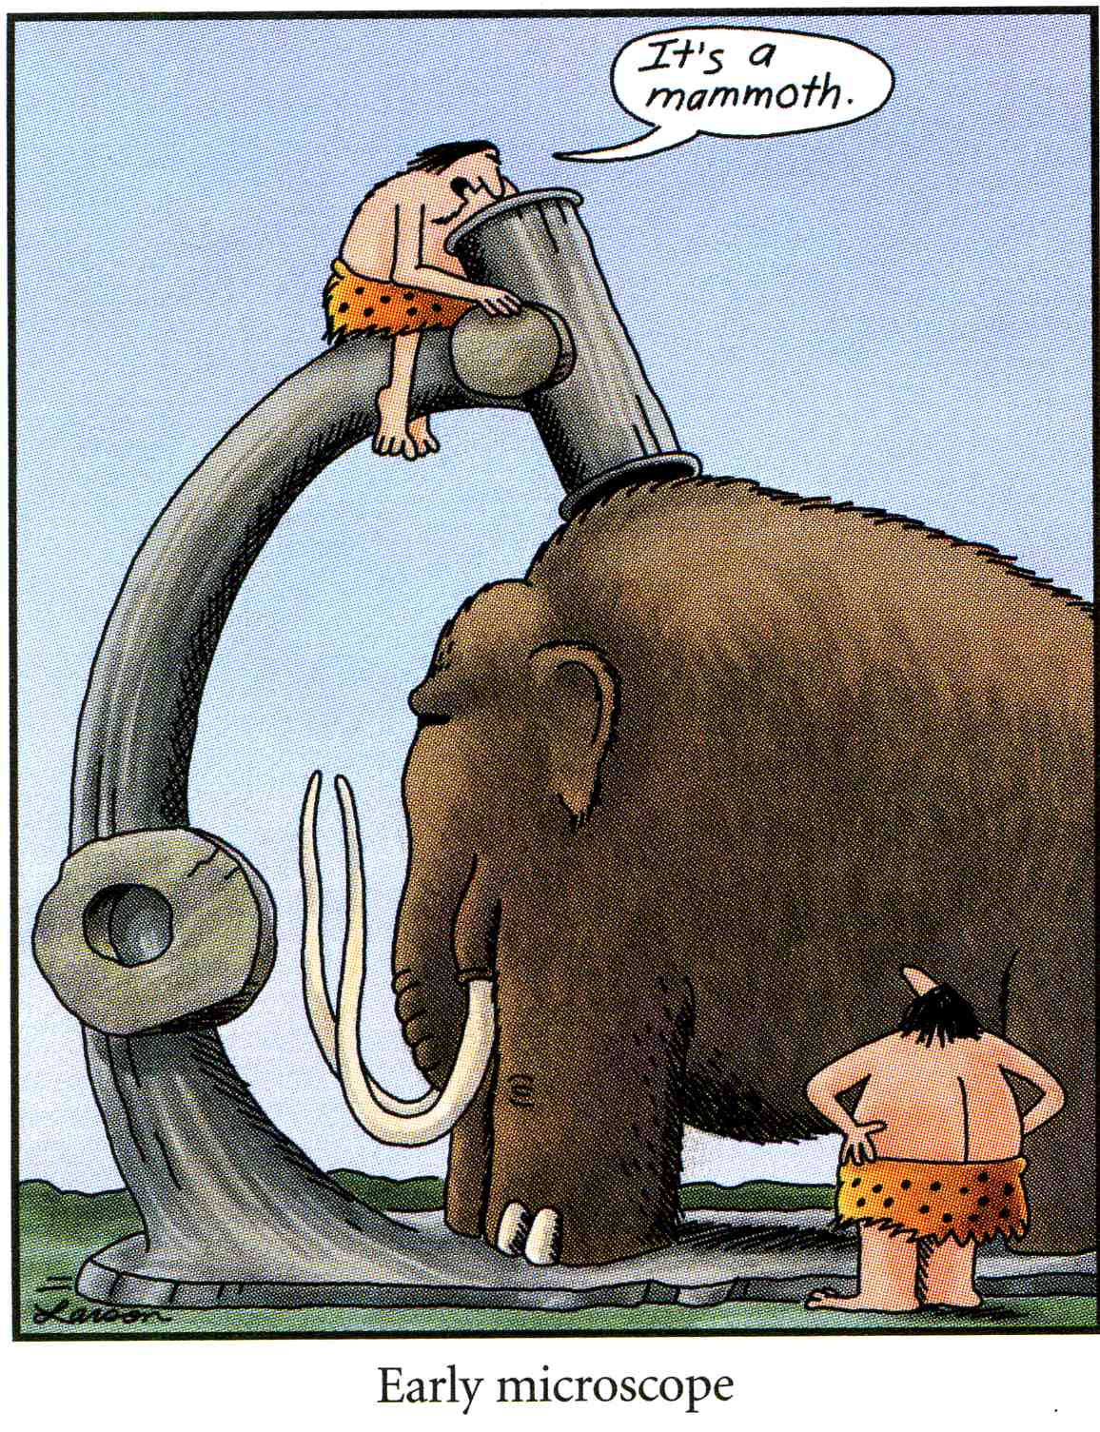
Choosing Instruments

Slide 5
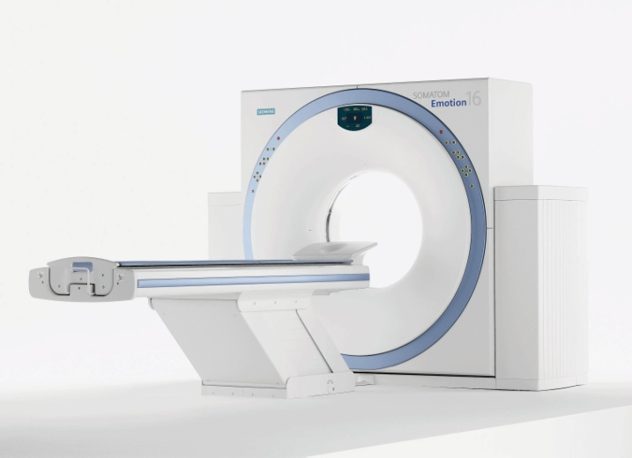
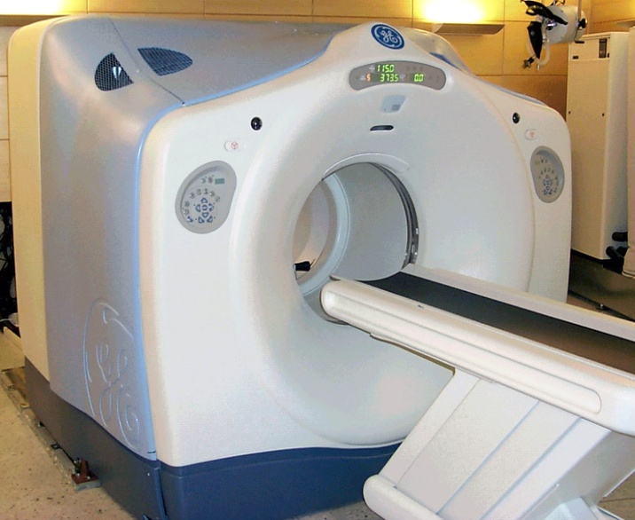
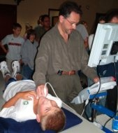
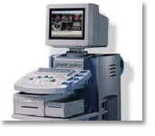
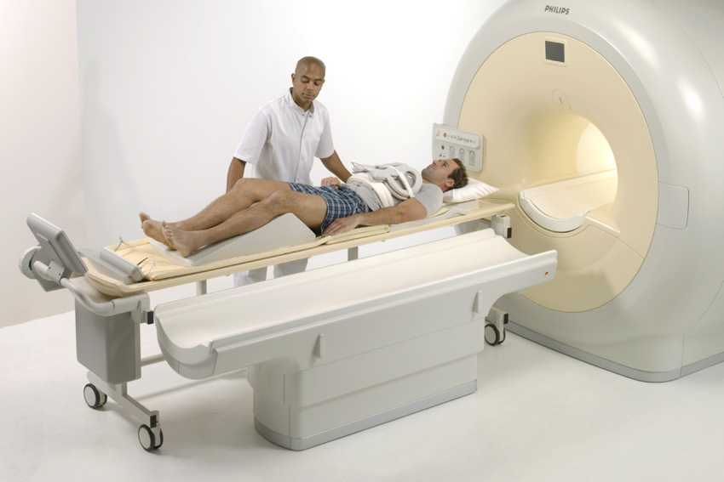
Clinical Biomedical Imaging
X-Ray, Computed Tomography
Magnetic Resonance Imaging
Nuclear Imaging
Ultrasound Imaging

Slide 6
Learning objectives
1
2
3
4
Explain physical and mathematical foundations
Characterize system performance using linear system theory
Define requirements and design basic diagnostic imaging system chain
Identify advantages and limitations of different imaging methods
Signal generation
Transfer function
Data acquisition
Resolution power
Matter interaction
Depiction fidelity
Data pre-processing
Dose, Safety
Signal detection
Noise propagation
Data reconstruction
Experimental use
Image reconstruction
Performance metrics
Data post-processing
Clinical use

Slide 7
Agenda

Slide 8
Agenda
-
Exercise #1
Exercise #2
Exercise #3
Exercise #4
Exercise #5
Exercise #6
Exercise #7
Exercise #8
Exercise #9
Exercise #10
Exercise #11
Exercise #12
-

Slide 9


Exercises
Matlab based (in groups of two); problem solving
Tue
Wed
Thu
Fri
Sat
Sun
Mon
Tue
Exercise #X
13-15 HG E7 Lecture
13-15 HG E19 Computer room
15-16 HG E7 Exercise (preparation)
15-16 HG E7 Exercise (solution, discussion)
Mon <23:59 Submit Solution in Moodle

Slide 10



Activity
?
My expertise in Matlab programming is ...
Basic
Intermediate
Excellent
What is Matlab?

Slide 11

Exam
Type Written, closed-book Personal 2-page formulary
Duration 120 min
Grading Submitted exercise results are graded.
A maximum bonus of 0.25 can be achieved and is added to the exam grade if a minimum of 9 exercises has successfully been accomplished.

Slide 12
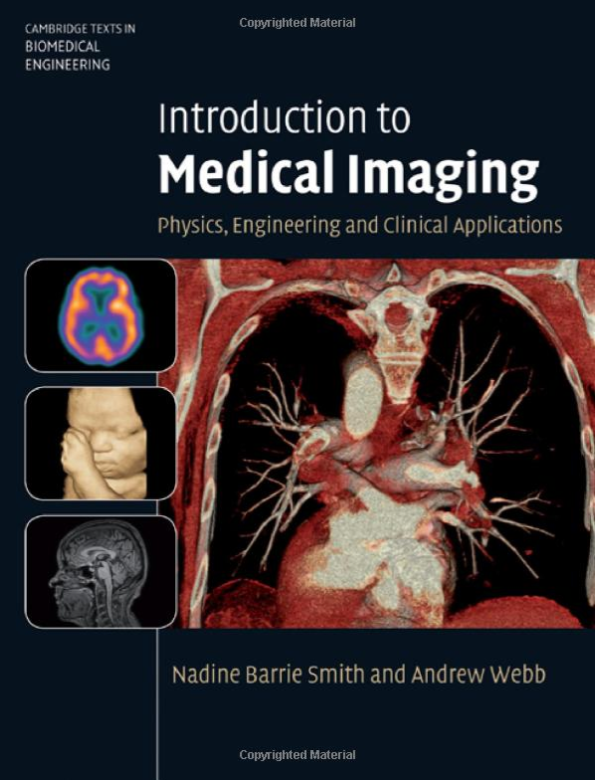
Lecture notes
Handouts + Exercises
https://moodle-app2.let.ethz.ch/course/view.php?id=11546
Book
Introduction to Medical Imaging
Cambridge University Press
Nadine Barrie Smith, Andrew Webb
www.library.ethz.ch ➔ online access

Slide 13
Book
Chapter 2.2-2.3

Slide 14
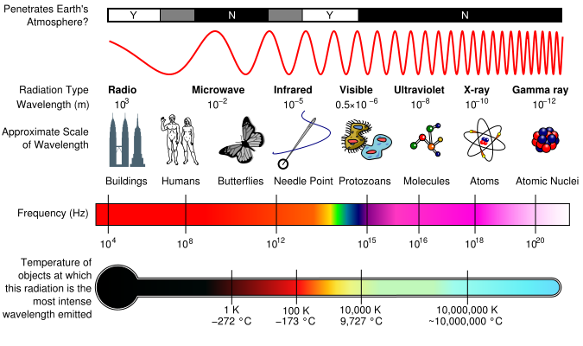
Electromagnetic radiation
Radiation absorption
Electric field:
Magnetic field:
Wave speed:
Energy:
Notes:
G-rays: <10 pm
X-rays: 10 pm – 10 nm
UV: 10 nm – 400 nm
Light: 400 nm – 750 nm
IR: 750 nm – 500 um
MW: 500 um – 10 cm
RF: >10 cm

Slide 15
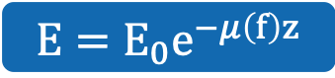

Electromagnetic wave attenuation
Electric field E₀
Electric field E
$$z$$
Frequency dependent attenuation coefficient
Wave attenuation
$$E=E_{0}e^{−μ\left(f\right)z}$$
Position

Slide 16
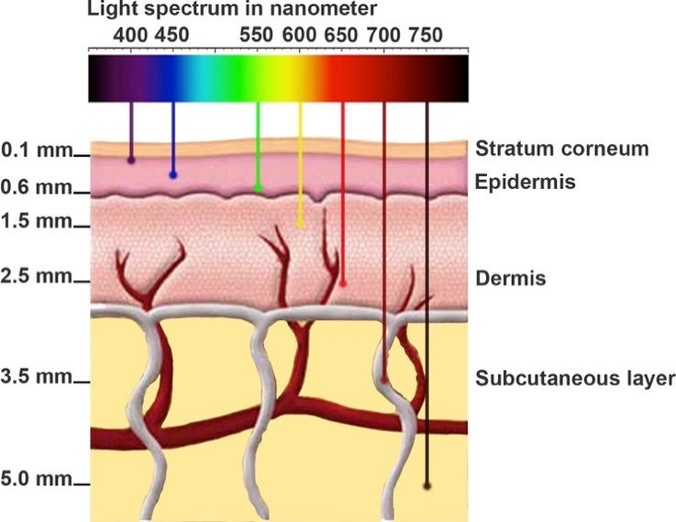

Attenuation
Wavelength $λ$ [nm]
Notes:
Red laser = 650 nm
Green laser = 530 nm

Slide 17
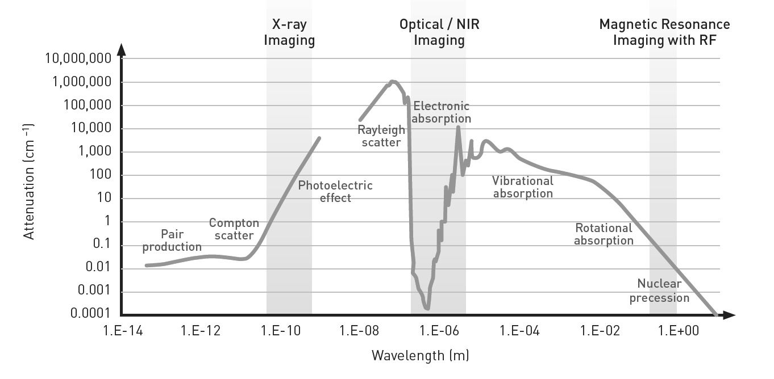
Attenuation
https://www.osa-opn.org/home/articles/volume_26

Slide 18
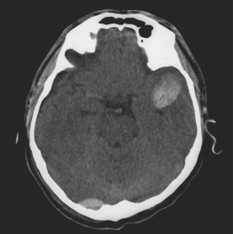
Biomedical Imaging
Radiation absorption
X-ray Imaging
Notes:
G-rays: <10 pm
X-rays: 10 pm – 10 nm
UV: 10 nm – 400 nm
Light: 400 nm – 750 nm
IR: 750 nm – 500 um
MW: 500 um – 10 cm
RF: >10 cm

Slide 19
Biomedical Imaging
Chapter 2.1-2.18
Imaging Mode: X-ray Imaging
Probe: X-ray photons
Wavelength: 10 pm – 10 nm
Matter interaction: absorption, scatter
Modalities: Projection imaging Digital Subtraction Angiography (DSA) Computed tomography

Slide 20
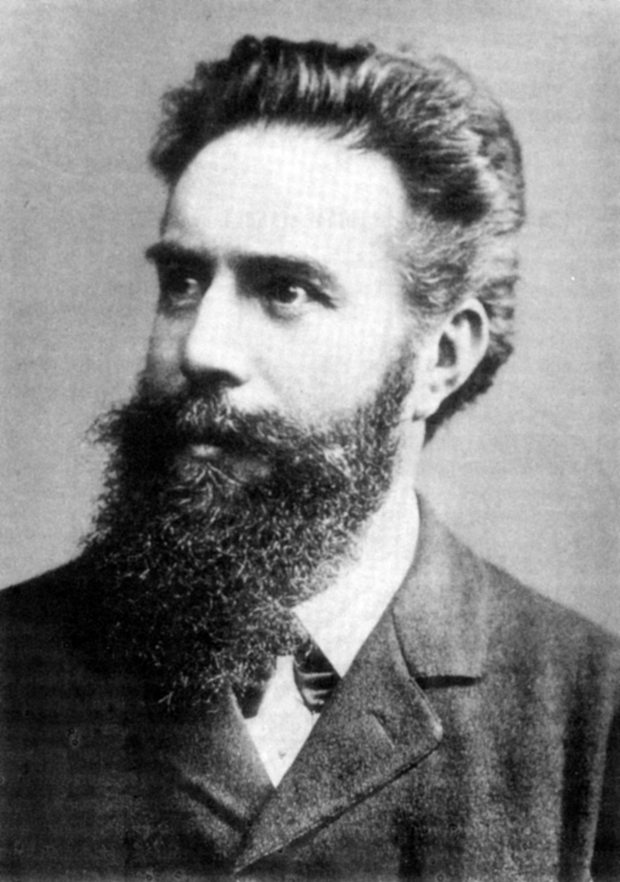
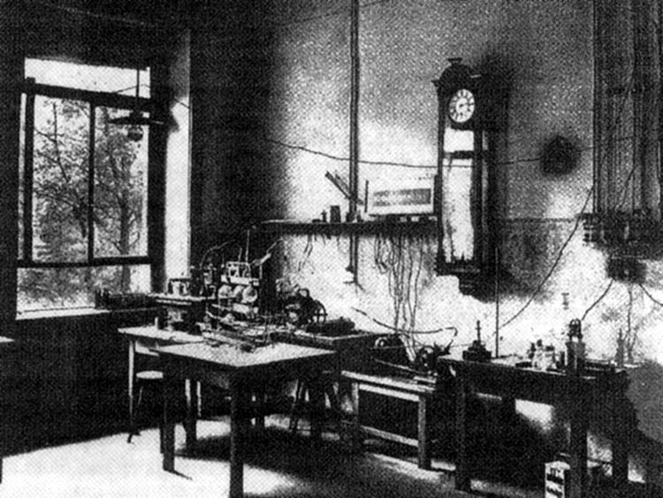
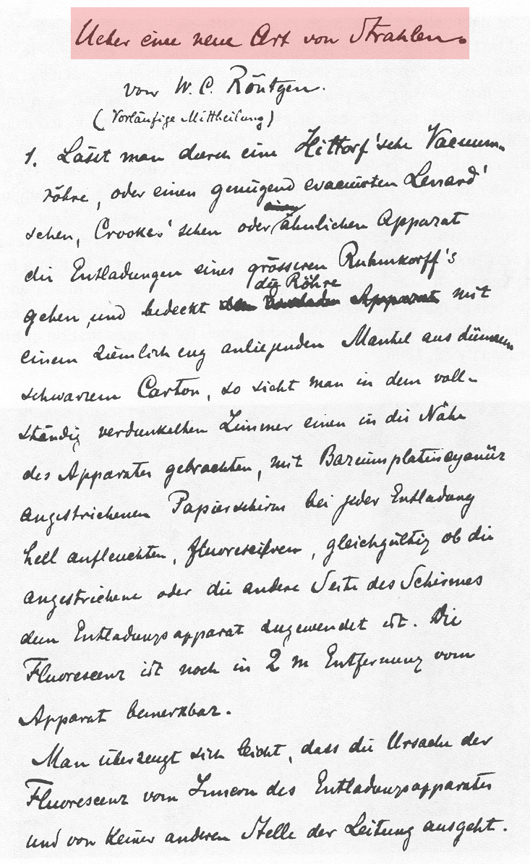
Wilhelm Conrad Röntgen, 1845-1923
Notes:
Notes
When the German physicist Wilhelm Conrad Röntgen did experiments on Cathode ray's with a Crookes tube, he discovered while working, that a plate of barium platinocyanide (fluorescent crystals) on a nearby table in his workroom glowed when he activated the tube. Even when he covered the tube with black material it kept glowing. Roentgen named this new phenomena X-Rays.
Wilhelm Conrad Röntgen (in English: "William Conrad Roentgen") (March 27, 1845 – February 10, 1923) was a German physicist, of the University of Würzburg, who, on November 8, 1895, produced and detected electromagnetic radiation in a wavelength range today known as x-rays or Röntgen Rays, an achievement that earned him the first Nobel Prize in Physics in 1901.
Röntgen was born in Lennep (now a part of Remscheid), Germany, to a clothmaker. His family moved to Apeldoorn in the Netherlands when he was three years old. He received his early education at the Institute of Martinus Herman van Doorn. He later attended Utrecht Technical School, from which he was expelled for producing a caricature of one of the teachers, a "crime" he claimed not to have committed.
In 1865, he tried to attend the University of Utrecht without having the necessary credentials required for a regular student. Hearing that he could enter the Federal Polytechnic Institute in Zurich, today the ETH Zurich, by passing its examinations, he began studies there as a student of mechanical engineering. In 1869, he graduated with a Ph.D. from the University of Zurich.
In the next experiments he used photographic material and made his first X-Ray picture, the hand of his wife Anna Bertha!

Slide 21
Generation of X-rays
Probe
Matter interaction
Detection
Image production

Slide 22
Generation
fast electrons
X-ray photons
target with heavy atoms
Electrons interact with inner e- shells of target (X-rays are not radioactive!)
Notes:
Blackboard
-> radiation consists of quanta
-> radiation energy is integer multiple of single quantum energy
-> single quantum energy depends on frequency -> Planck: E = h ⋅ ν = e ⋅ U (h = 6.62⋅10⁻³⁴ Js; 1 Js = 1 W/s²)
-> because of energy quantization radiation can be considered a particle stream (particle = photon)
-> E = m ⋅ c² -> impulse of photon: p = m ⋅ c = h ⋅ ν / c (photons always travel at speed of light)
Notes
The electronvolt (eV) is the amount of kinetic energy gained by a single unbound electron when it passes
through an electrostatic potential difference of one volt, in vacuum. In other words, it is equal to one volt
(1 volt = 1 joule per coulomb) times the charge of a single electron (in coulombs). 1 eV = 1.6⋅10⁻¹⁹ J

Slide 23
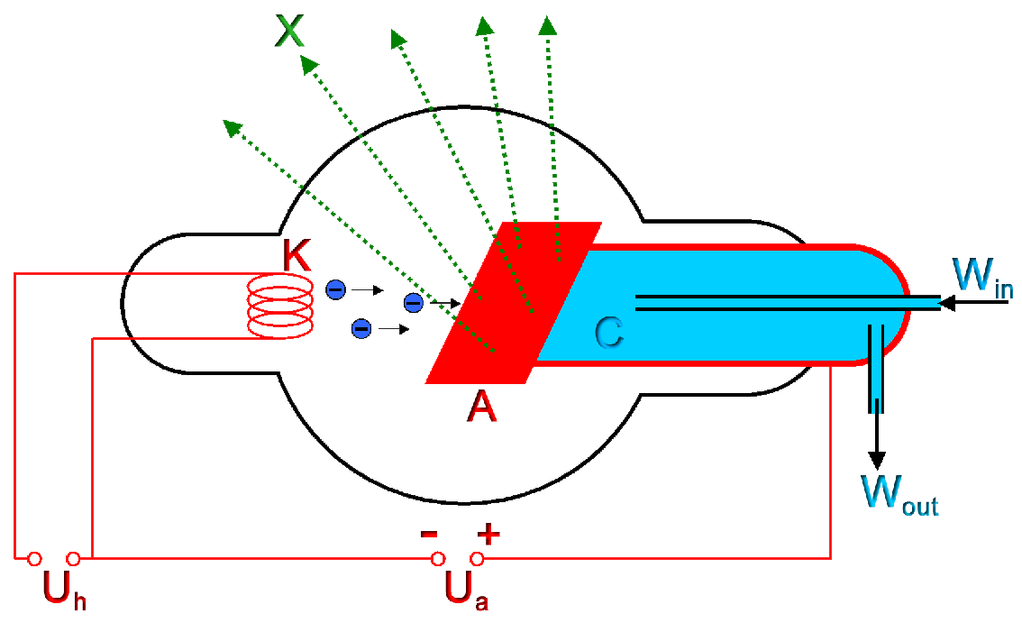
Generation – X-ray tube
Acceleration of electron in vacuum tube ( U_{A} = 30-200 kV, I_{A} = 50-100 mA)
Notes:
Blackboard
-> wanted: λ_{min} = h ⋅ c / e ⋅ U (U = 100 kV)
-> λ_{min} = 6.6⋅10⁻³⁴ Js ⋅ 3⋅10⁸ m/s / 1.6⋅10⁻¹⁹ C / 1⋅10⁵ V = 1.25 ⋅ 10⁻¹¹ m = 12.5 pm (remember: 1V = 1J/C)
Notes
-> 1 ångström (Å) = 10^{–10} metres = 0.1 nm = 100 pm
-> λ of typical diagnostic X-rays: 10 pm-10 nm

Slide 24
Generation – Bremsstrahlung
c
X-ray photon
fast
electron
slower
nucleus
Fast-moving electron decelerates when it swings around a heavy nucleus:
electron interacts with electrons in outer shells
energy depends on distance at which electron passes nuclei
spectrum continuous 0 -> E_{max}
interaction depends on Z value and E of electrons
Notes:
Notes
Bremsstrahlung (help·info), (from the German bremsen, to brake and Strahlung, radiation, thus, "braking radiation" or "deceleration radiation"), is electromagnetic radiation produced by the acceleration of a charged particle, such as an electron, when deflected by another charged particle, such as an atomic nucleus. The term is also used to refer to the process of producing the radiation. Bremsstrahlung has a continuous spectrum. The phenomenon was discovered by Nikola Tesla during high frequency research he conducted between 1888 and 1897.

Slide 25
Generation – Characteristic radiation
1)
2)
3)
photo electron
“hole”
K
L
+
K
L
K
L
+
+
electron
Fast-moving electron interacts tightly with bound electrons in target:
K-shell electron is ejected
Electron energy E_{electron} > E_{binding, K}
Discrete energy of emitted radiation E = E_{binding,K} – E_{binding,L}
Notes:
Blackboard
-> emitted photon energy: ΔE = E_{N}-E_{K} = h ⋅ ν
-> exercise: what is the maximum energy of X-rays from a tungsten target?
-> solution: maximum energy x-rays are generated if a zero-energy electron jumps onto K shell
-> binding energy of electrons E_{binding} = 13.6 eV ⋅ Z²_{eff}
-> Z_{w} = 74 -> E_{max} = h ⋅ ν = 13.6 eV (74-2)² = 70.5 keV (Z_{eff} ~ (Z–2) for nuclei with large Z since electrons with l=0 shield nuclei)
-> λ_{min} = h ⋅ c / E_{max} = 6⋅10⁻³⁴ Js ⋅ 3⋅10⁸ m/s / ( 70.5⋅10³/1.6⋅10¹⁹ J) = 40 pm

Slide 26
Interaction of X-rays
Probe
Matter interaction
Detection
Image production

Slide 27
Attenuation – Photo effect
1)
2)
3)
photo electron
“hole”
+
+
+
incident photon
Photo effect leads to total absorption of photon:
Generation of characteristic x-ray radiation with low energy
Photo electrons cause biological “damage” ➔ “ionizing radiation”
Probability ~ ρ ⋅ Z³/E³
Notes:
Blackboard
-> energy of incident photon E_{Incidence} = E_{Ejection} + ½ ⋅ m_{e} ⋅ ν²

Slide 28
Attenuation – Compton effect
Back-scatter
Side scatter
Forward scatter
scattered photon
incident photon
recoil electron
Compton effect leads to photon “bouncing”:
Photon loses (part of) its energy to kinetic energy of electron
Detection of photon changes
Recoil electron responsible for “biological” damage
Probability ~ ρ/E
Notes:
Blackboard
-> Compare with billiard hit -> sketch photon hitting an electron a) before hit b) after hit (after hit impulse of photon is p’, of electron P’_{e})
-> conservation of energy: p ⋅ c + mc² = p’ ⋅ c + E’_{e} -> ( p – p’ + mc)² = ( E’_{e}/c )²
-> conservation of momentum: p – p’ = p’_{e}
-> square both sides: p² – 2p⋅p’+p’² = p’_{e}² (p ⋅ p’ = p ⋅ p’ ⋅ cosϕ )
-> further calc
-> λ’-λ = h/(mc) ⋅ (1-cos ϕ) (Compton effect)
-> Scatter problem!

Slide 29
Detection of X-rays
Probe
Matter interaction
Detection
Image production

Slide 30
Projection Imaging
Chemical reaction/ Light/Electrons
Incident x-rays
Detector
Aluminum filter
Transmitted/ scattered X-rays
Probe
Matter interaction
Detection
Image production
Notes:
Notes
-> Low energy photons do not reach the detector
- absorbed in x-ray tube material and patient (Dose)
- No contribution to the image
-> Inherent filtering in tube (glass, oil, target)
-> Additional filtering to reduce patient dose (aluminum sheets between

Slide 31
Projection imaging – Image intensifier
incident radiation
scintillating screen + photocathode
e-
e-
e-
e-
e-
U_{DC}
photoanode + digital
output screen
Notes:
Notes
An X-ray image intensifier (XRII) refers to a special image intensifier device used in medical imaging involving x rays. It consists of an input window, input phosphor, photocathode, vacuum and electron optics, output phosphor and output window. It allows for lower x-ray doses to be used on patients by magnifying the intensity produced in the output image, enabling the viewer to easily see the structure of the object being imaged.

Slide 32
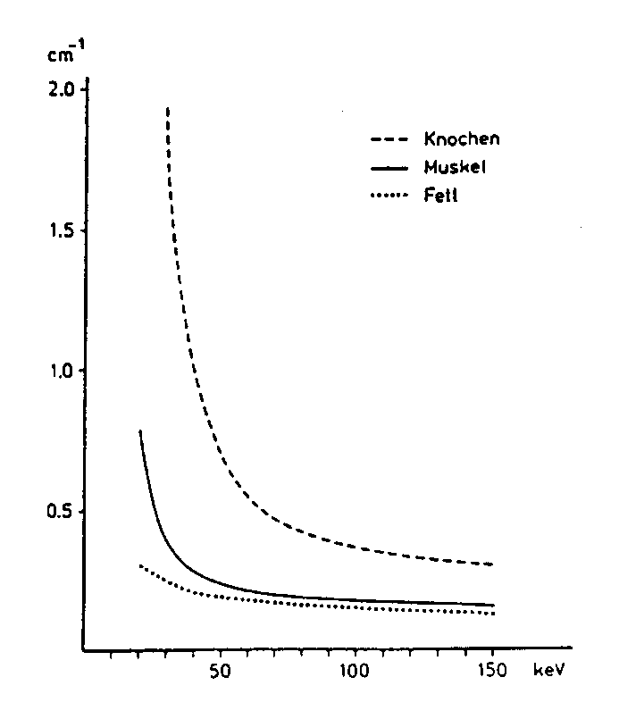
Projection Imaging – Contrast
bone
muscle
fat
Linear attenuation coefficient
energy
Notes:
Blackboard
-> scetch object with bone and soft tissue
-> illustrate weighted average of μ in case of heterogeneous composition along d

Slide 33
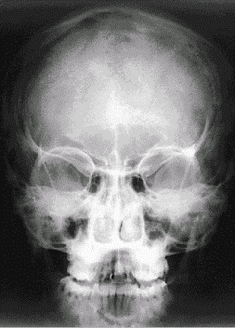
Projection Imaging – Contrast
Large contrast between bone and tissue/air
Very little contrast among different tissues
Notes:
Blackboard
-> I/I₀=exp(-μd) -> display μ ~ -log(I/I₀)
-> calculate maximum contrast between air and average biological tissue with d = 20 cm (and μ=0.35 cm⁻¹ w/o bone or air): I/I₀ = exp(-μd) = exp(-7) = 1/1000
-> calculate maximum contrast between air and bone tissue with d = 20 cm (and μ=0.7 cm⁻¹): I/I₀ = exp(-μd) = exp(-14) = 8/10000000

Slide 34
Computed Tomography
Probe
Matter interaction
Detection
Image production

Slide 35
Projection versus Tomographic imaging
Projection imaging
= 3D structures are collapsed onto 2D image:
- details are obscured - low soft-tissue contrast - not quantitative
Tomographic imaging
= 3D structure is resolved:
- slices (“gr: Tomos = slice”)
- Computed image reconstruction
- Projection imaging and CT share same principles of x-ray generation, interaction, detection

Slide 36
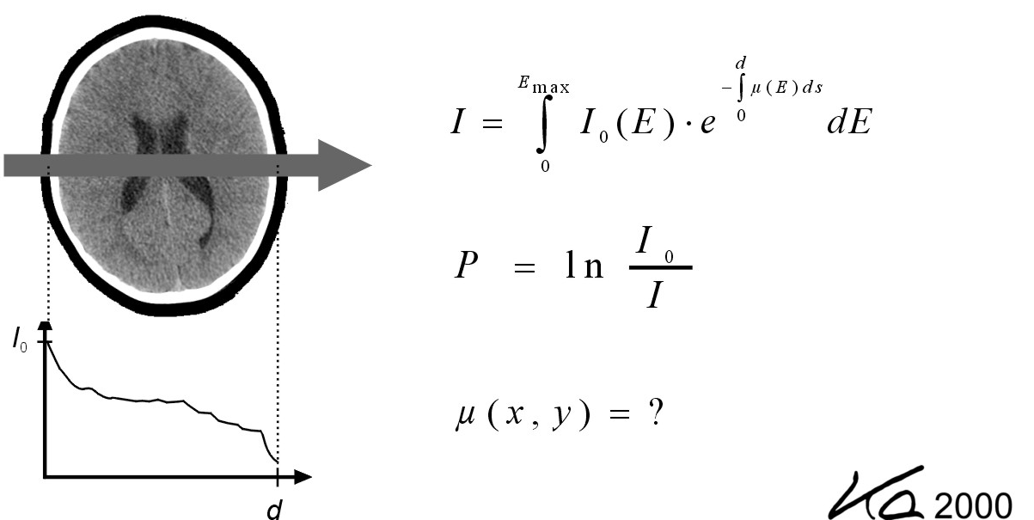
CT – Reconstruction problem
Adapted from Kalender WA, Computed Tomography, ISBN 3-89578-216-5

Slide 37
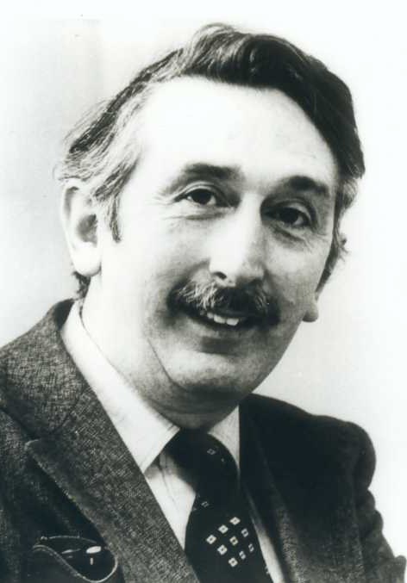
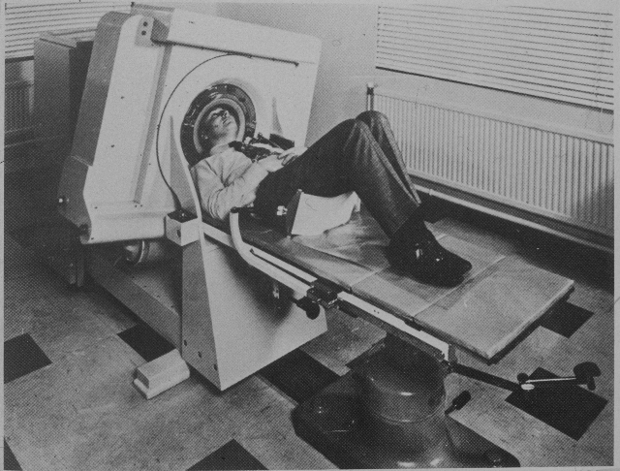
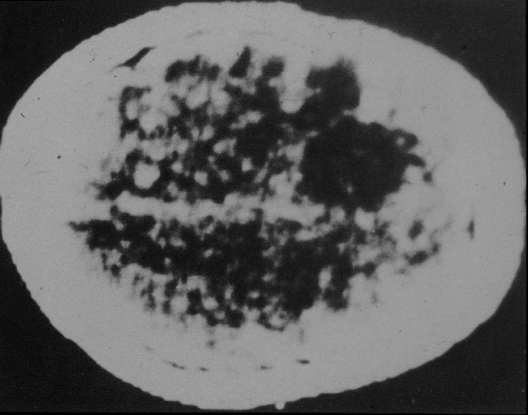
Godfrey Hounsfield, 1919 – 2004
Notes:
Sir Godfrey Newbold Hounsfield CBE (28 August 1919 – 12 August 2004) was an English electrical engineer who shared the 1979 Nobel Prize for Physiology or Medicine with Allan McLeod Cormack for his part in developing the diagnostic technique of computerized axial tomography (CAT).His name is immortalised in the Hounsfield scale, a quantitative measure of radiodensity used in evaluating CAT scans. The scale is defined in Hounsfield units (symbol HF), running from air at -1000 HF, through water at 0 HF, and up to bone at +1000 HF.

Slide 38
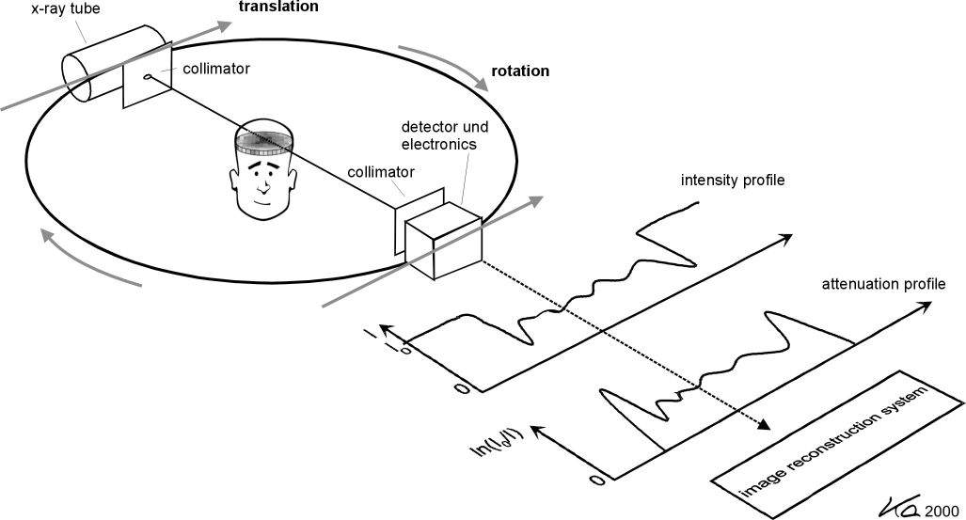
CT – Principle
Adapted from Kalender WA, Computed Tomography, ISBN 3-89578-216-5

Slide 39

CT – Image reconstruction
Adapted from Kalender WA, Computed Tomography, ISBN 3-89578-216-5

Slide 40
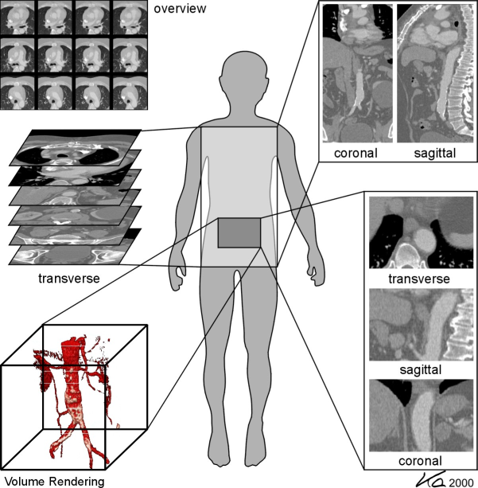
CT – Applications

Slide 41
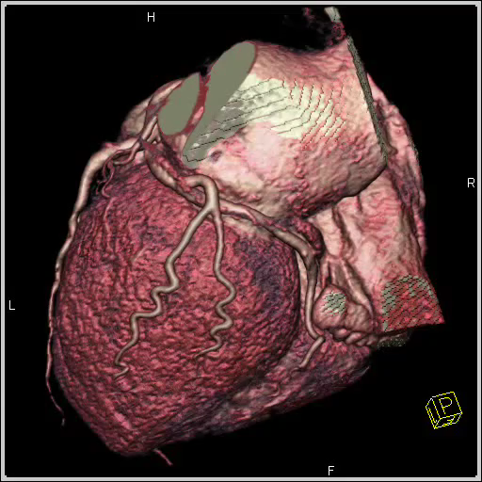
CT – Applications
Adapted from Kalender WA, Computed Tomography, ISBN 3-89578-216-5

Slide 42
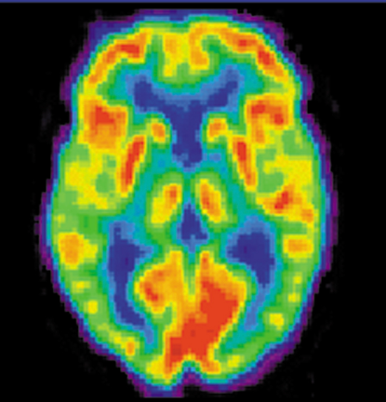
Biomedical Imaging
Radiation absorption
Nuclear Imaging
Notes:
G-rays: <10 pm
X-rays: 10 pm – 10 nm
UV: 10 nm – 400 nm
Light: 400 nm – 750 nm
IR: 750 nm – 500 um
MW: 500 um – 10 cm
RF: >10 cm

Slide 43
Biomedical Imaging
Chapter 3.1-3.21
Imaging Mode: Nuclear Imaging (SPECT, PET)
Probe: γ-ray photon, positron→ γ-ray photons
Wavelength: 2 pm – 100 pm
Matter interaction: absorption, scatter, pair production
Modalities: SPECT (Single Photon Emission Tomography ) PET (Positron Emission Tomography)

Slide 44
Positron Emission
Probe
Matter interaction
Detection
Image production

Slide 45
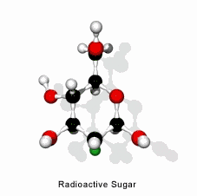
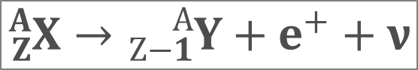
PET – Positron Emission
Isotope Half-life
Carbon-11 20 min
Nitrogen-13 10 min
Oxygen-15 2 min
Fluorine-18 110 min
Gallium-68 68 min
Rubidium-82 1.25 min
Fluorodeoxyglucose (FDG)
$${}_{Z}^{A}X→{}_{Z−1}^{A}Y+e^{+}+ν$$
Positron

Slide 46
Positron Annihilation
Probe
Matter interaction
Detection
Image production

Slide 47
PET – Annihilation
Compton scattering
γ(511 keV)
e-
positron emitting radionuclide
γ(511 keV)
Coincidence detection of two γ-rays gives information on location of
positron-electron anihilation (not on location of radionuclide)

Slide 48
Coincidence Detection
Probe
Matter interaction
Detection
Image production

Slide 49
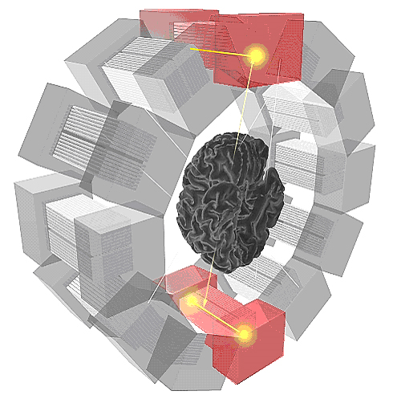
PET – Detector
γ - rays
Image courtesy of HUG
Scintillation Detector
Coincidence Detection

Slide 50
Image Production
Probe
Matter interaction
Detection
Image production

Slide 51
PET – Image Production
Lines of Response (LoR’s)
Raw data image
(Back Projection)
Regridding to
Cartesian frame
Filtered Image
(e.g. Hanning Filter)
Slide courtesy of Markus Rudin, AIC

Slide 52
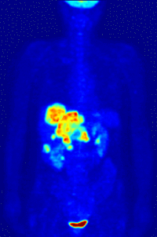
FDG – PET
www.wikipedia.com
Notes:
Oncology: PET scanning with the tracer fluorine-18 (F-18) fluorodeoxyglucose (FDG), called FDG-PET, is widely used in clinical oncology. This tracer is a glucose analog that is taken up by glucose-using cells and phosphorylated by hexokinase (whose mitochondrial form is greatly elevated in rapidly-growing malignant tumours). A typical dose of FDG used in an oncological scan is 200-400 MBq for an adult human. Because the oxygen atom which is replaced by F-18 to generate FDG is required for the next step in glucose metabolism in all cells, no further reactions occur in FDG. Furthermore, most tissues (with the notable exception of liver and kidneys) cannot remove the phosphate added by hexokinase. This means that FDG is trapped in any cell which takes it up, until it decays, since phosphorylated sugars, due to their ionic charge, cannot exit from the cell. This results in intense radiolabeling of tissues with high glucose uptake, such as the brain, the liver, and most cancers. As a result, FDG-PET can be used for diagnosis, staging, and monitoring treatment of cancers, particularly in Hodgkin's disease, non Hodgkin's lymphoma, and lung cancer. Many other types of solid tumors will be found to be very highly labeled on a case-by-case basis-- a fact which becomes especially useful in searching for tumor metastasis, or for recurrence after a known highly-active primary tumor is removed. Because individual PET scans are more expensive than "conventional" imaging with computed tomography (CT) and magnetic resonance imaging (MRI), expansion of FDG-PET in cost-constrained health services will depend on proper health technology assessment; this problem is a difficult one because structural and functional imaging often cannot be directly compared, as they provide different information. Oncology scans using FDG make up over 90% of all PET scans in current practice.

Slide 53
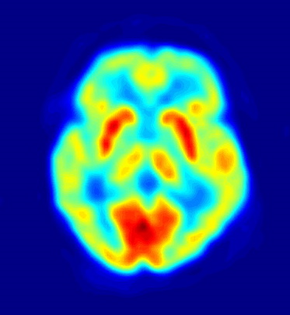
FDG – PET
www.wikipedia.com
Notes:
Oncology: PET scanning with the tracer fluorine-18 (F-18) fluorodeoxyglucose (FDG), called FDG-PET, is widely used in clinical oncology. This tracer is a glucose analog that is taken up by glucose-using cells and phosphorylated by hexokinase (whose mitochondrial form is greatly elevated in rapidly-growing malignant tumours). A typical dose of FDG used in an oncological scan is 200-400 MBq for an adult human. Because the oxygen atom which is replaced by F-18 to generate FDG is required for the next step in glucose metabolism in all cells, no further reactions occur in FDG. Furthermore, most tissues (with the notable exception of liver and kidneys) cannot remove the phosphate added by hexokinase. This means that FDG is trapped in any cell which takes it up, until it decays, since phosphorylated sugars, due to their ionic charge, cannot exit from the cell. This results in intense radiolabeling of tissues with high glucose uptake, such as the brain, the liver, and most cancers. As a result, FDG-PET can be used for diagnosis, staging, and monitoring treatment of cancers, particularly in Hodgkin's disease, non Hodgkin's lymphoma, and lung cancer. Many other types of solid tumors will be found to be very highly labeled on a case-by-case basis-- a fact which becomes especially useful in searching for tumor metastasis, or for recurrence after a known highly-active primary tumor is removed. Because individual PET scans are more expensive than "conventional" imaging with computed tomography (CT) and magnetic resonance imaging (MRI), expansion of FDG-PET in cost-constrained health services will depend on proper health technology assessment; this problem is a difficult one because structural and functional imaging often cannot be directly compared, as they provide different information. Oncology scans using FDG make up over 90% of all PET scans in current practice.

Slide 54
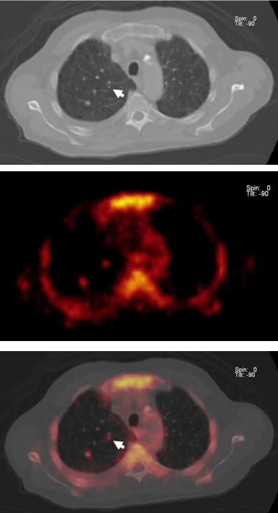
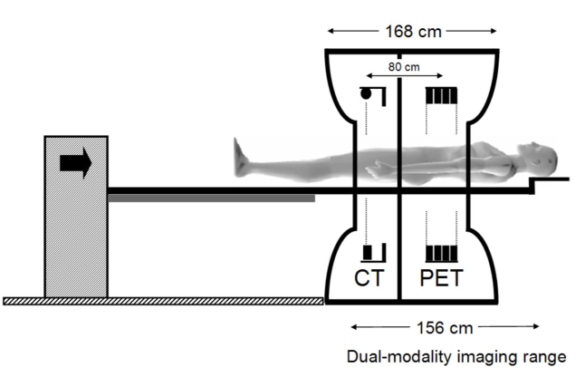
PET – CT
CT
PET
Fusion
From Kalender WA, Computed Tomography, ISBN 3-89578-216-5

Slide 55
Biomedical Imaging
Radiation absorption
Magnetic Resonance Imaging
Notes:
G-rays: <10 pm
X-rays: 10 pm – 10 nm
UV: 10 nm – 400 nm
Light: 400 nm – 750 nm
IR: 750 nm – 500 um
MW: 500 um – 10 cm
RF: >10 cm

Slide 56
Biomedical Imaging
Chapter 5.1-5.23
Imaging Mode: Magnetic Resonance (MR)
Probe: radiofrequency waves
Wavelength: 5 – 150 cm
Matter interaction: nuclear spin transitions
Modalities: Magnetic Resonance Imaging (MRI) Magnetic Resonance Spectroscopy (MRS) Functional MRI (fMRI)

Slide 57
Magnetic Resonance
Probe
Matter interaction
Detection
Image production

Slide 58
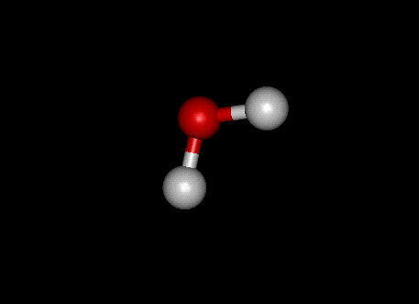
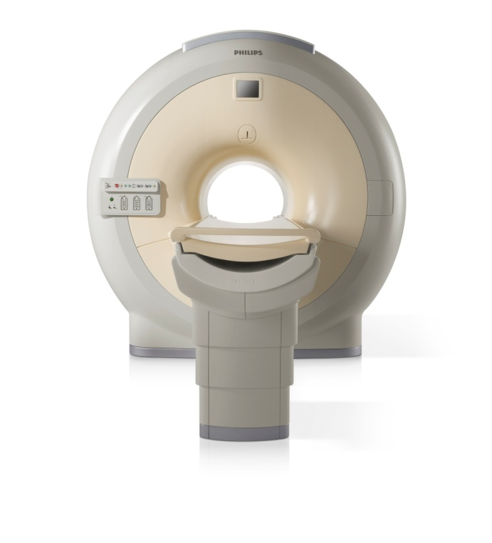

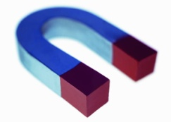
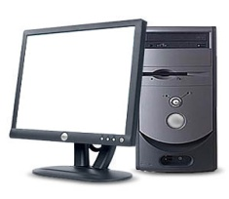
Magnetic Resonance Imaging
Radiofrequency transmitter
Position ➔ Frequency
Signal source²⁾
Radiofrequency antennae
Magnet¹⁾
Frequency ➔ Position
MRI system
¹⁾ 0.5-14 Tesla
²⁾ 1H, 31P, 13C, 19F

Slide 59
Signal source – Protons
Oxygen
Hydrogen
Hydrogen
Proton has non-zero spin I=1/2
Oxygen has zero spin I=0

Slide 60
Signal source in external magnetic field
Magnetic field B₀
Precession about B₀ with Larmor frequency: ω₀=γ B₀; γ =42.6 MHz/T

Slide 61
Signal source in external magnetic field
Magnetic field B₀
Magnetization M
-
γhB₀
Population difference =
~
+
2kT
Excess of “up” spins at 1.5 Tesla: 5*10-6

Slide 62
Magnetic Resonance Imaging
Radiofrequency transmitter
Position ➔ Frequency
Signal source²⁾
Radiofrequency antennae
Magnet¹⁾
Frequency ➔ Position
MRI system
¹⁾ 0.5-14 Tesla
²⁾ 1H, 31P, 13C, 19F

Slide 63
Detection
Detector
Transmit radiofrequency (RF) energy
Magnetic field B₀
Voltage U
Voltage U = δΦ/δt~ωM

Slide 64
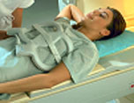
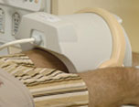
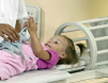
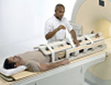
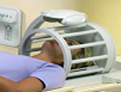
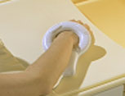
Detectors

Slide 65
MR Imaging
Probe
Matter interaction
Detection
Image production

Slide 66
Magnetic Resonance Imaging
Radiofrequency transmitter
Position ➔ Frequency
Signal source²⁾
Radiofrequency antennae
Magnet¹⁾
Frequency ➔ Position
MRI system
¹⁾ 0.5-14 Tesla
²⁾ 1H, 31P, 13C, 19F

Slide 67
Position ➔ Frequency
ΔB=B-B₀
G_{z}=dB/dz
0
z
ω(z)=γ (B₀+ΔB)
“Lamor frequency”
Notes:
Die Tonskala und die Frequenzskala lassen sich also ineinander umrechnen, allerdings ist der Zusammenhang nicht linear. Fortschreitende Oktavabstände (a1 - a2 - a3...) sind in der Tonskala äquidistant (man denke z.B. an die konstanten Oktavabstände auf der Klaviertastatur). Sie entsprechen jedoch nicht konstanten Frequenzintervallen, sondern die Frequenz verdoppelt sich jeweils von Oktave zu Oktave (a1 = 440 Hz, a2 = 880 Hz, a3 = 1760 Hz,...). Daraus ergibt sich folgender mathematischer Zusammenhang zwischen der Frequenz f0 eines Tones und der Frequenz fx eines um x Oktaven höheren Tones:
fx = f0 *2^x

Slide 68

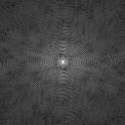
Fourier imaging
Object space
Data space¹⁾
FT
G_{x}
G_{y}
G_{z}
RF
¹⁾ also: k-space; k = spatial frequency

Slide 69
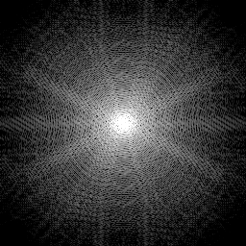

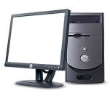
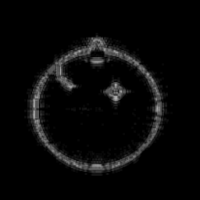
Data space ↔ Object space
Data space¹⁾
Object space
IFT
IFT
¹⁾ also: k-space; k = spatial frequency

Slide 70
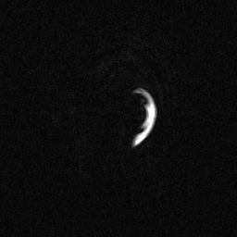
MRI – Anatomy

Slide 71

MRI – Angiography

Slide 72

MRI – Heart

Slide 73
Ultrasound Imaging
Probe
Matter interaction
Detection
Image production

Slide 74
Biomedical Imaging
Chapter 4.1-4.14
Imaging Mode: Ultrasound
Probe: acoustic waves
Wavelength: 0.07 – 1.5 mm
Matter interaction: scattering, absorption
Modalities: Echography Doppler Imaging Thermal Therapy

Slide 75
Biomedical Imaging
Electromagnetic waves
Do NOT require medium to transmit
Energy stored in propagating electromagnetic fields
Wave velocity is constant
Acoustic waves
DO require medium to transmit
Energy transport by mechanical displacement
Wave velocity depends on medium properties
Notes:
G-rays: <10 pm
X-rays: 10 pm – 10 nm
UV: 10 nm – 400 nm
Light: 400 nm – 750 nm
IR: 750 nm – 500 um
MW: 500 um – 10 cm
RF: >10 cm

Slide 76

Ultrasound Imaging
Piezoelectric transducer
Acoustic wave
Scattering/absorption

Slide 77


Ultrasound Imaging
High-resolution liver imaging
Color-Doppler flow imaging

Slide 78

Ultrasound Imaging
3D Ultrasound – Aortic regurgitation
Philips Healthcare

Slide 79

Activity
?
Arrange imaging methods according to wave frequency involved (high to low) …

Slide 80
“The most important slides”
#1
#2
#3
#4
#5
#6
#7
#8
#9

Slide 81

Contact information
Prof. Sebastian Kozerke
Phone: 044 632 3549
Email: kozerke@biomed.ee.ethz.ch
Prof. Klaas Pruessmann Phone: 044 632 6696
Email: pruessmann@biomed.ee.ethz.ch
Institute for Biomedical Engineering
Gloriastrasse 35 8092 Zurich

